Slide 1
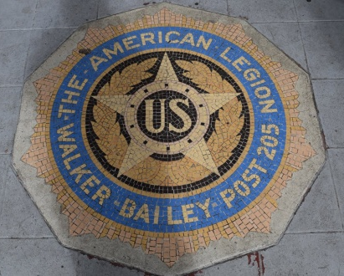
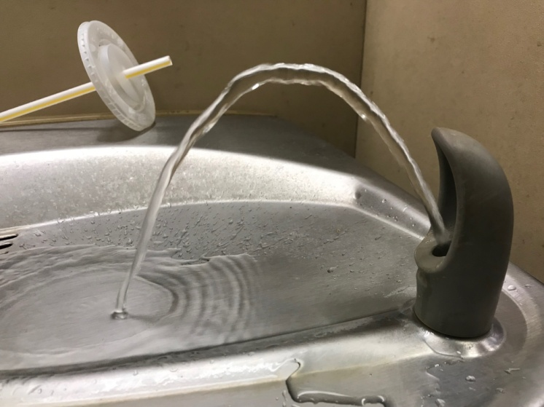
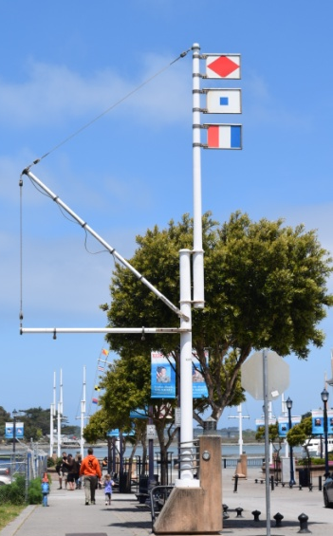
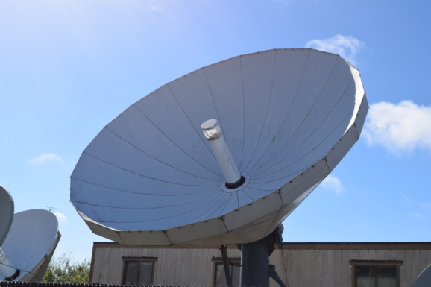
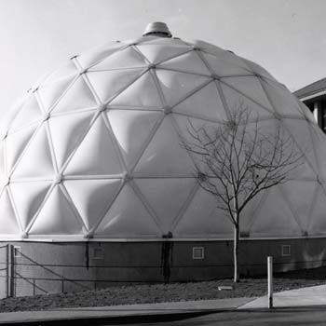
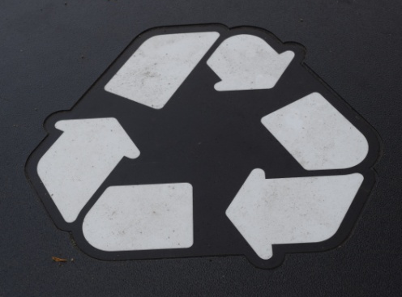
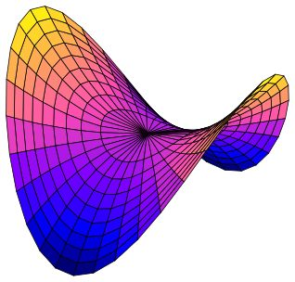
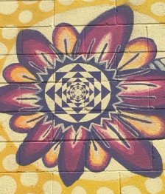
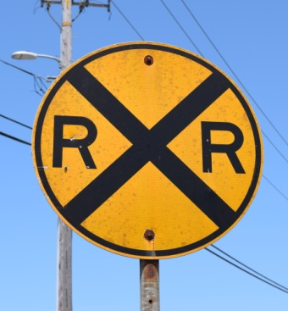
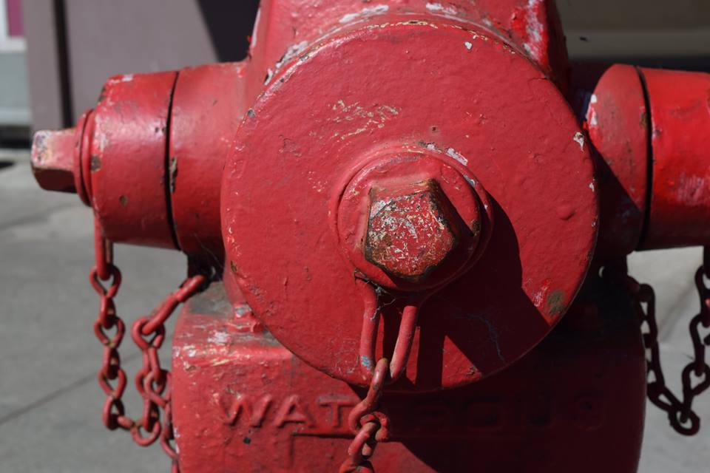
A Field Guide to Math in Humboldt
Humboldt Math Festival

Slide 2
About the field guide
The Field Guide to Math in Humboldt is inspired by the MAA Field Guild to Math on the National Mall. We hope this will likewise inspire people, particularly students, to look at the world with a bit more appreciation of mathematics in the natural and man-made world. If you have ideas or suggestions please drop me an email. Likewise, if you find an error or have a better explanation, let me know. The field guide items are also being posted on the Humboldt Math Festival Facebook page. We are also hoping to create a program of loaning a class set of digital cameras to classes so they can document their own discoveries of math around their school and homes. If you have an small digital camera you are no longer using, we would love to put it to good use. Give Ken Pinkerton a call at (707) 845-7465.

Slide 3
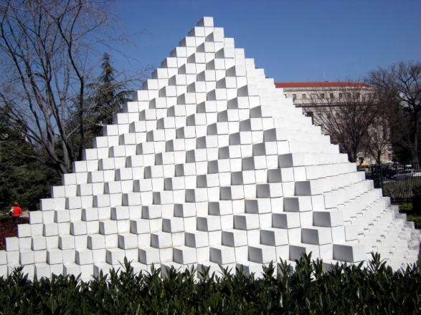
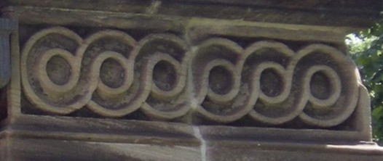
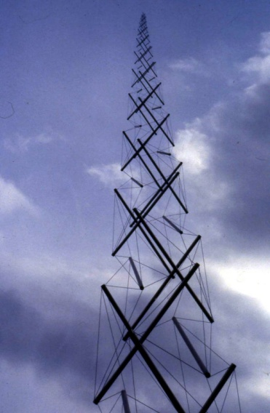
MAA FIELD GUIDE
Topics:
Splitting a Trapezoid
An Irresistible Edge
Hexagons and Pentagons
Fractal Branches
LeWitt?s Pyramid
Needle Tower
MÃ¶bius Continuum
The Washington Right Triangle
Recycling Topology
Knot or Unknot?
Water Fountain Geometry
Manhole Covers
Infinity in Eight Minutes
Unit Signs

Slide 4
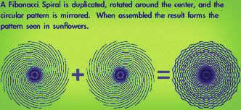
Fibonacci Spiral No 1
In the alley off C street, between 2nd & 3rd, Eureka. Artist unknown.
Source: http://4.bp.blogspot.com/-Q8UYvWnKot0/UZARD7_U-xI/AAAAAAAAPl0/kCaWYfrDsao/s640/sunflower+sequence.jpg

Slide 5
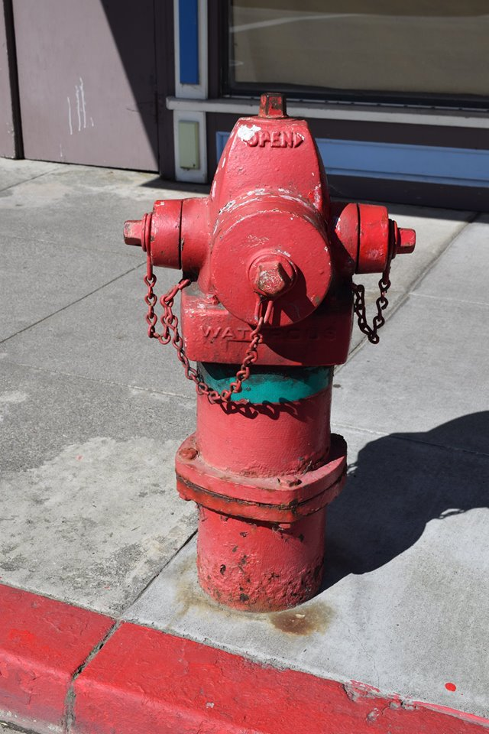
Pentagons – Fire Hydrants No.2
Fire hydrants have pentagonal nuts which require a special 5 sided wrench.

Slide 6
3. Stars: Pentagonal & Decagram

Slide 7
Mobius Strip No. 4
Mobius Strip recycle symbol. The symbol was created in 1970 by Gary Anderson in response to a contest sponsored by Container Corporation of America to raise awareness of environmental issues. The photo is from the new Eureka recycle bins in the old town area
Source: https://brookstonbeerbulletin.com/mobius-beer/

Slide 8
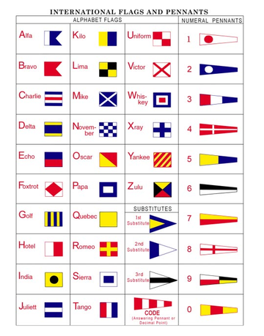
5. Codes: International Flags
Use the International Alphabet Flags sheet to read the flags on the foot of F Street and on the Board Walk in Eureka.
Flag page source: https://www.caruanamarine.com/images/stories/virtuemart/product/code-flag-single-b.png

Slide 9
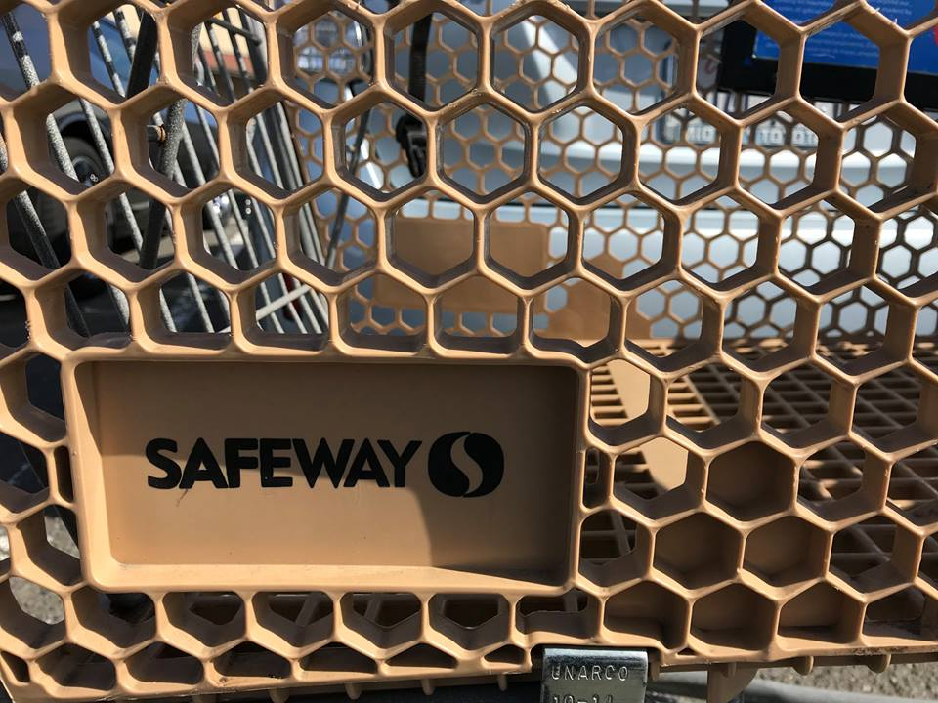
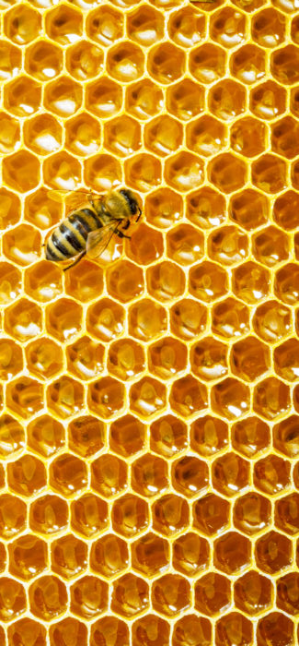
Hexagons No. 6
Hexagons are structurally very strong shape, as evidenced by their use in shopping carts and honeycombs.

Slide 10
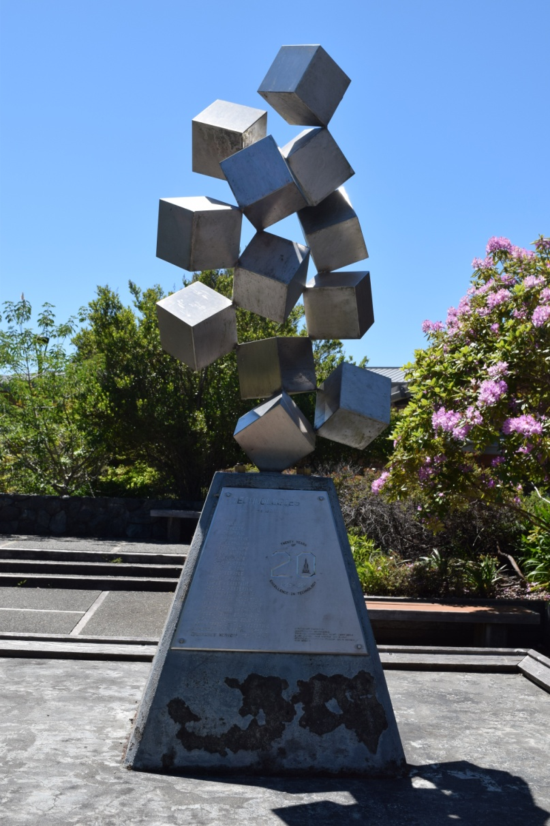
Technologies: Building Blocks to Career Success No. 7
Sculpture by Tom McCorkendale. "Technologies: Building Blocks to Career Success" College of the Redwoods, outside the Technology complex. In honor 20 years of the CR Technology programs, 1985. The sculpture is even mounted with special cube nuts on the base.

Slide 11
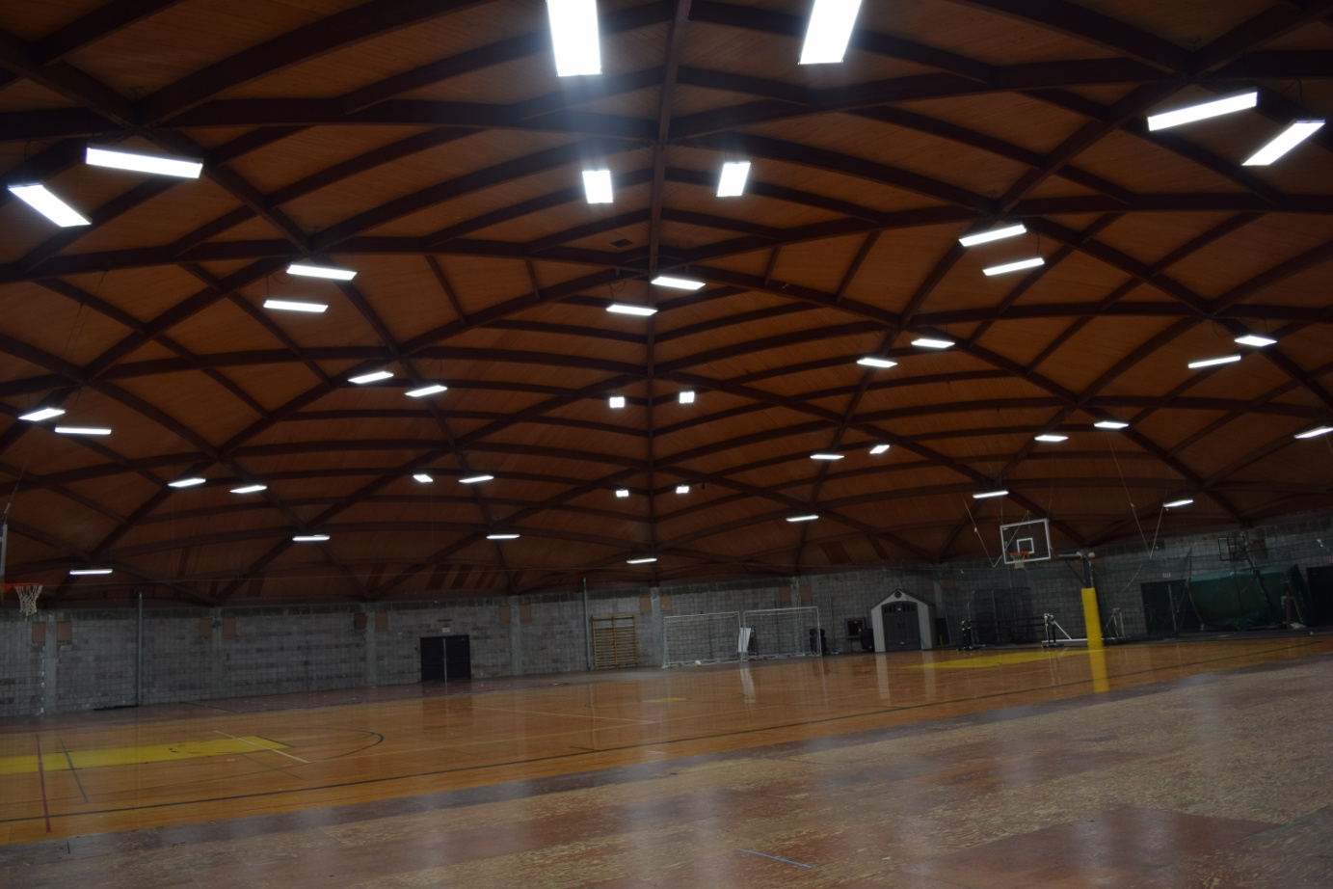
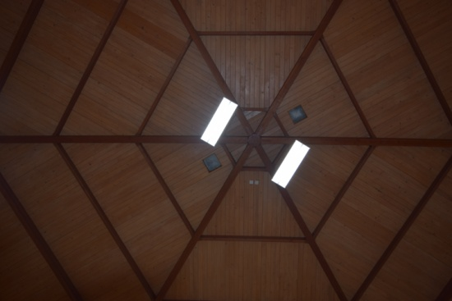
8. College of the Redwoods Field House
The Field House at College of the Redwoods. A wonderful 24 sided building
with a pentagonal support system making a domed roof.

Slide 12
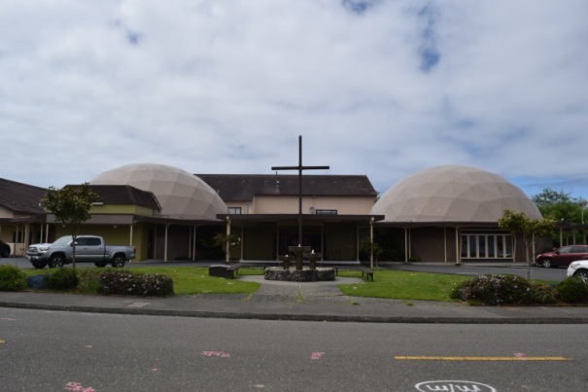
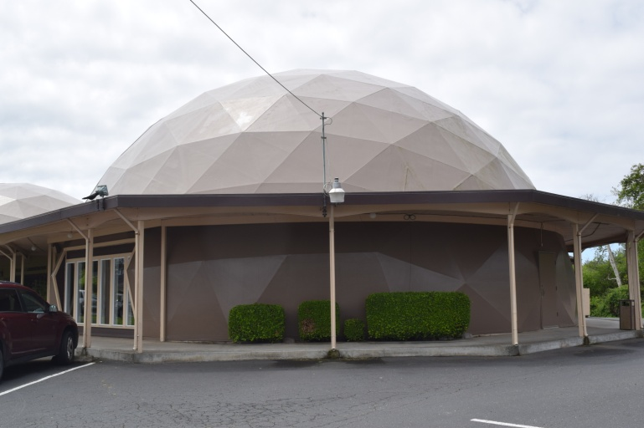
9. Geodesic Domes
The Humboldt State University, Dennis K. Walker Greenhouse was opened in 1982. Faith Center Foursquare Church on Bay Street, Eureka has two connected domes. The play structure is in Newburg Park, Fortuna. There are several geodesic dome homes in Fortuna and Eureka.

Slide 13
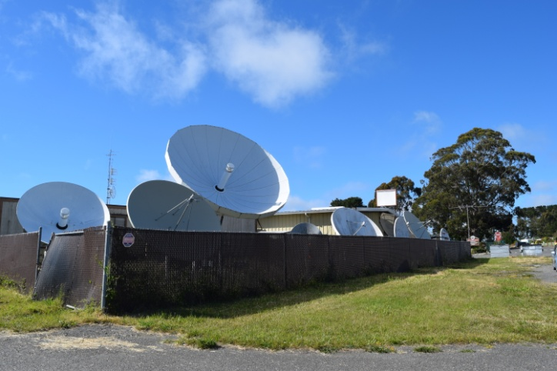
10. Parabolic Reflectors
A parabola reflects all the energy coming into
a central or "focal point". Conversely, energy
emitted from the focal point is sent straight
in a beam like a flashlight (which is a parabolic
mirror behind the bulb). These parabolas are
located at KIEM TV at the base of Humboldt
Hill

Slide 14
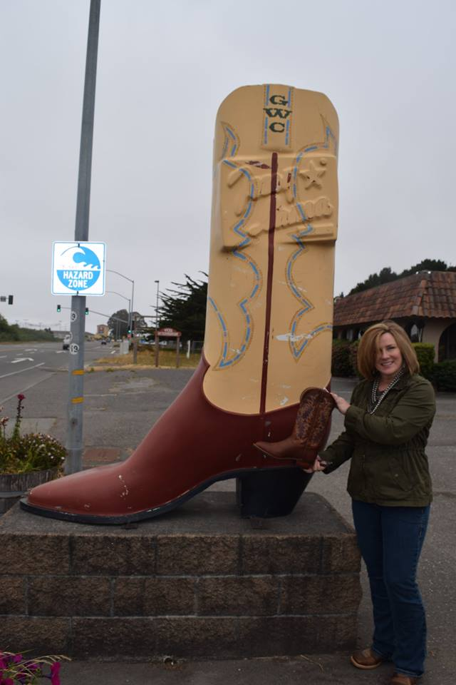
11. Ratios: Giant Tony Llama Boot
The giant Tony Llama boot outside Great Western Clothing Company at 4465 Broadway . The fiberglass boot measures 84.5 inches tall. A similar Tony Llama boot is 15 inches tall. The ratio is 1:5.63 inches from original to the model.
Special thanks to Crystal McBride at Great Western for allowing me to measure the boots and posing with the boots too.

Slide 15
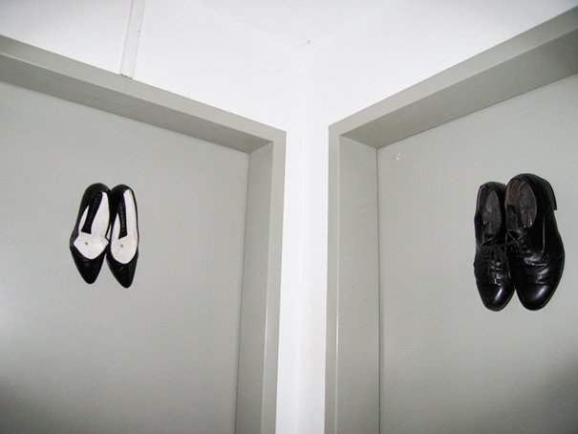
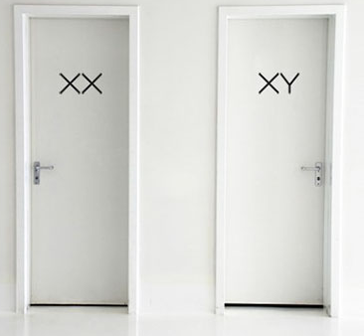
Bathroom Door Trivia Question
.
What shapes do you find around the symbols of a women's and men’s bathroom?
Source: https://www.boredpanda.com/funny-bathroom-signs

Slide 16
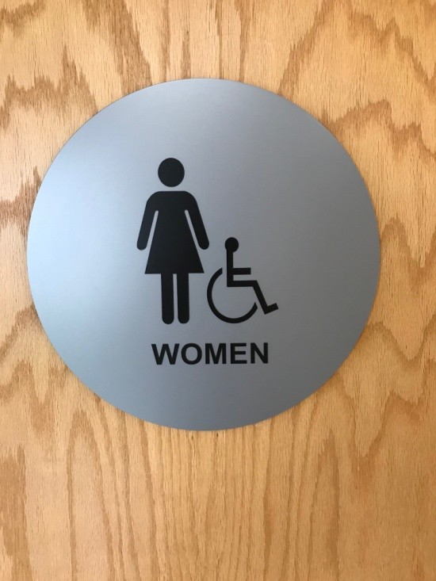

Slide 17
13. Road Sign Trivia Questions
Easy
1. What is the only octagonal sign?
2. What is the only triangular sign?
Harder
3. What is the only round road sign?
4. What sign is in the shape of an X?

Slide 18
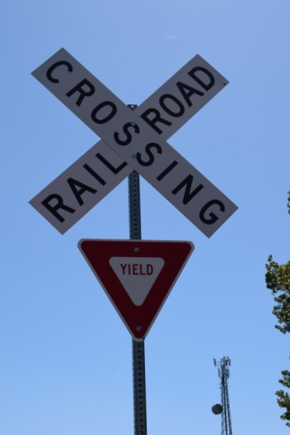
Road Sign Trivia Answers
1
4
2 & 4

Slide 19
Waves No 14

Slide 20
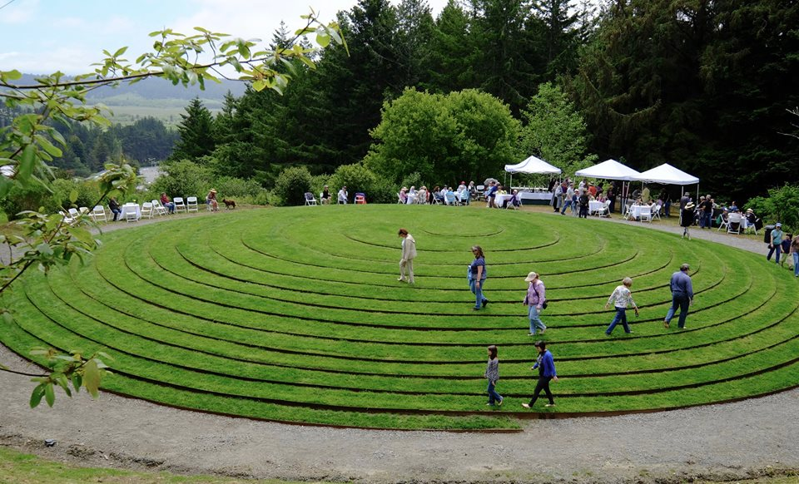
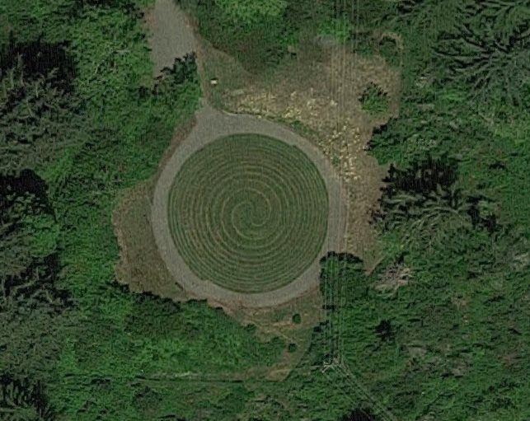
15 Spiral of Fermat
https://goo.gl/maps/G6sFUdw1KBD2
Find it (and walk it) at the Humboldt Botanical Garden, off Tompkins Hill Rd on the
College of the Redwoods Eureka campus. Utilizing 3D computer software, Fermat’s Spiral was input, drafted and then extruded to create a mound that rises to 6 feet at its center. Designed by Peter Santino.

Slide 21
CeNCOOS Ocean Observing System Humboldt Bay No. 16
The Central and Northern California Ocean Observing System (CeNCOOS) monitors ocean environmental conditions from Pt. Conception to the Oregon border with stations in Humboldt Bay and Trinidad. Check it out: https://www.cencoos.org/data/shore/humboldt

Slide 22
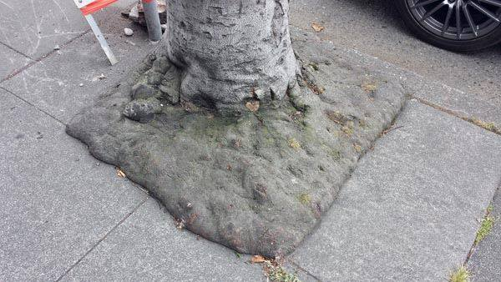
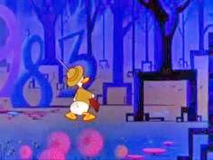
Square Roots! No. 17
Outside Chase Bank , F Street, Eureka. Tip-of-the-hat to Tami Matsumoto for the photo and info.
Donald Duck in Mathmagic Land

Slide 23
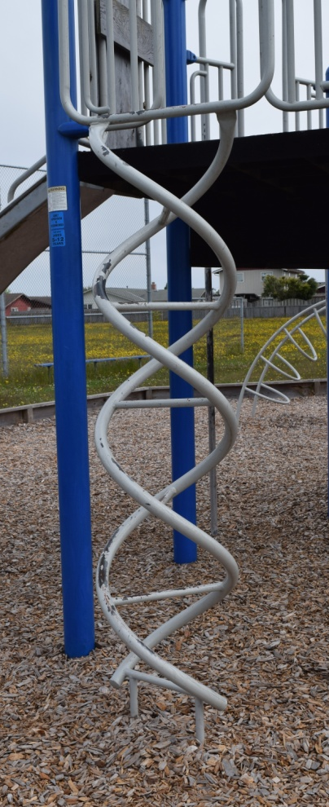
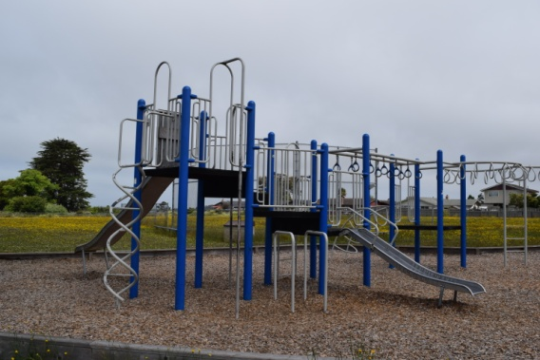
18. Double Helix
Pine Hill School, Eureka
Illustration source: http://chittagongit.com/icon/dna-helix-icon-0.html

Slide 24
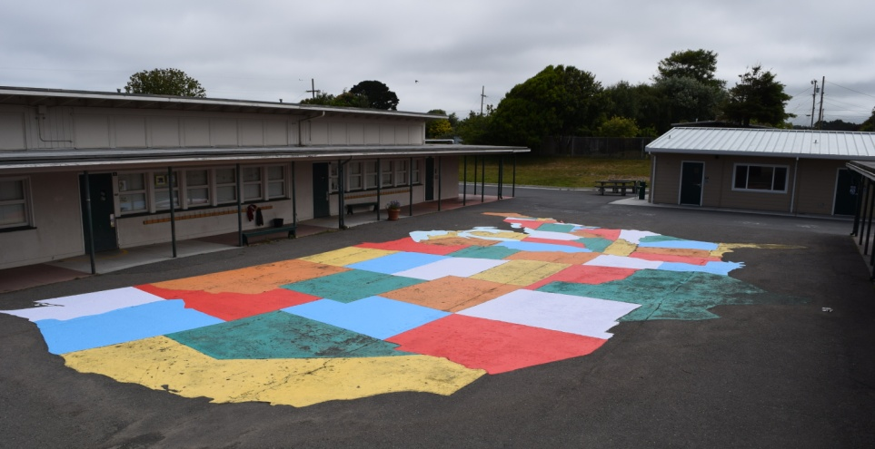
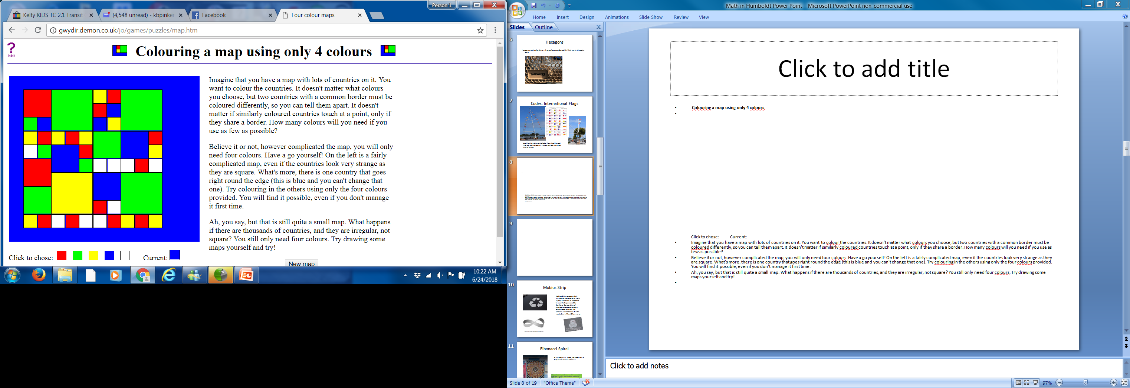
19. How Many Colors on a Map?
Alice Birney School, Eureka
Web source: http://gwydir.demon.co.uk/jo/games/puzzles/map.htm

Slide 25
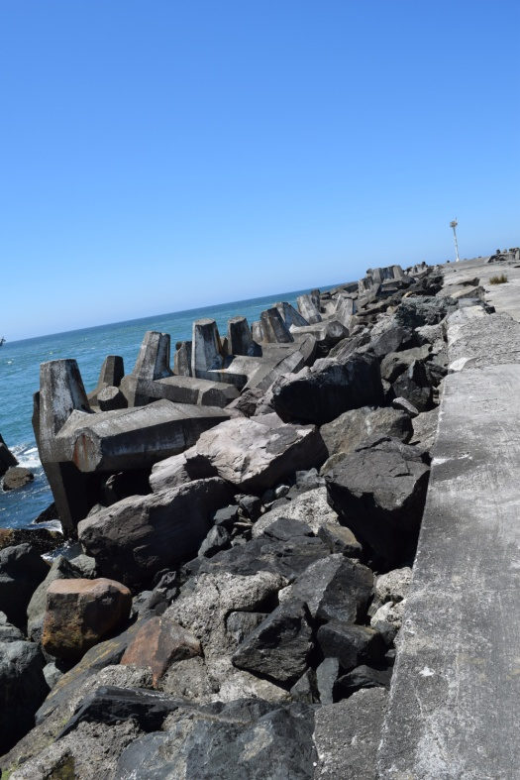
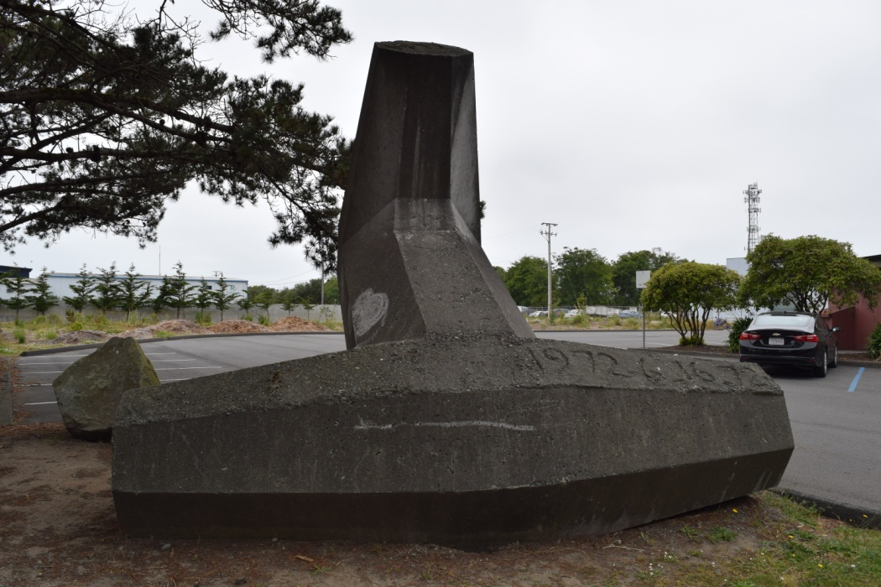
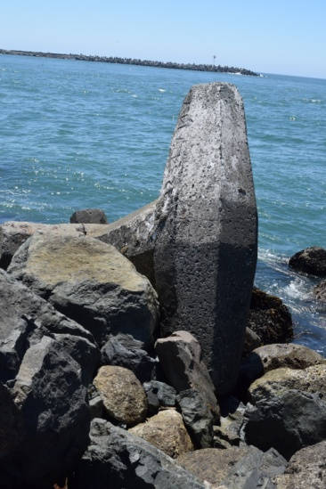
20. Dolosse
Dolos (plural Dolosse) are massive 42 ton steel reinforced concrete bodies that have the appearance of a capital H with tapering arms and one of the uprights turned 90 degrees. Almost 5000 dolosse reinforce the north and south jetty to prevent erosion and storm damage.

Slide 26
21 Hexagon & Radial Symmetry
Fire hydrant on the back of
Target. Thanks to Shayne Sines
For the photo and info.

Slide 27
22 Internal Symmetry
Angels of Hope Thrift Store, Arcata.
Thanks to Jessica Rasband for the
Photo and info.

Slide 28
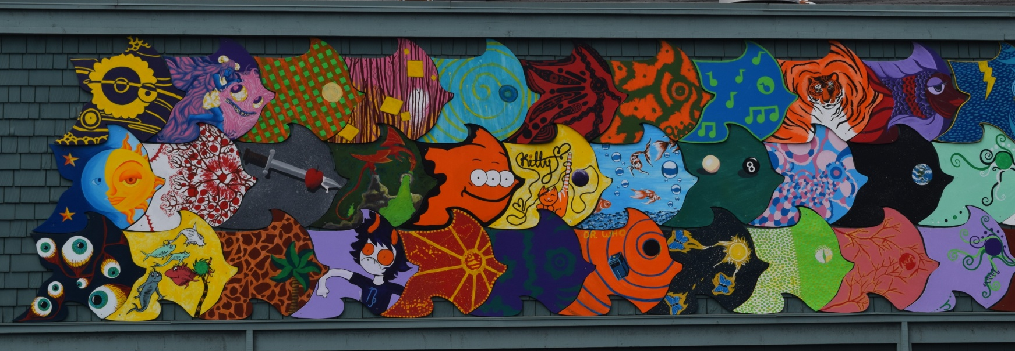
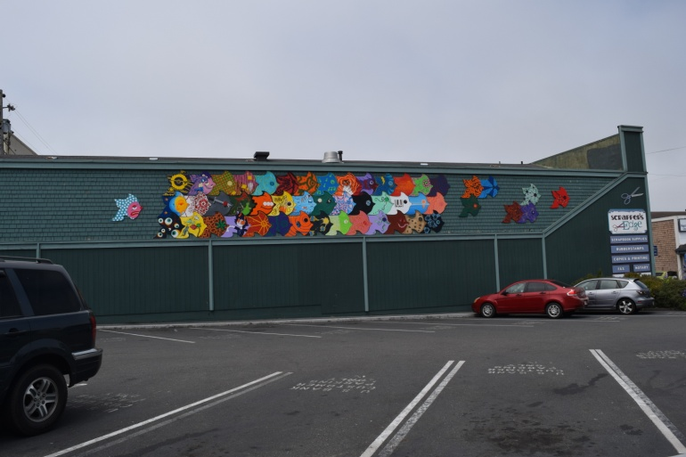
22 Tessellations Scrapper’s Edge
Scrapper’s Edge, Eureka. Created by
Katie Texas

Slide 29
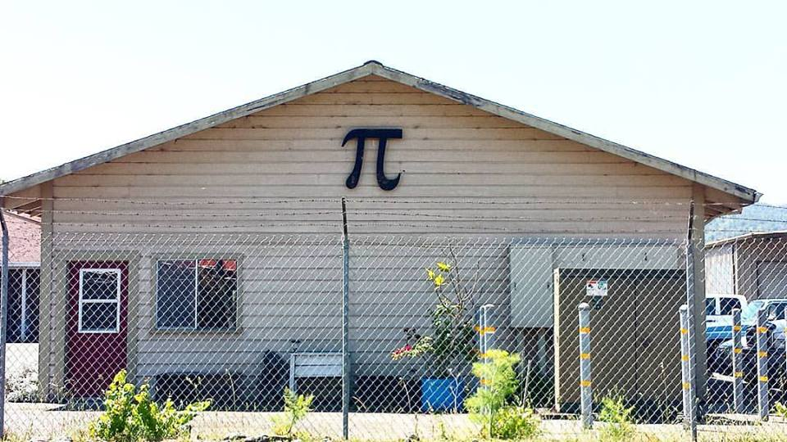
23 Pi Symbol
Blue Lake
Photo by Tami Matsumoto

Slide 30
25 Venn Diagram
Fortuna Family Practice

Slide 31
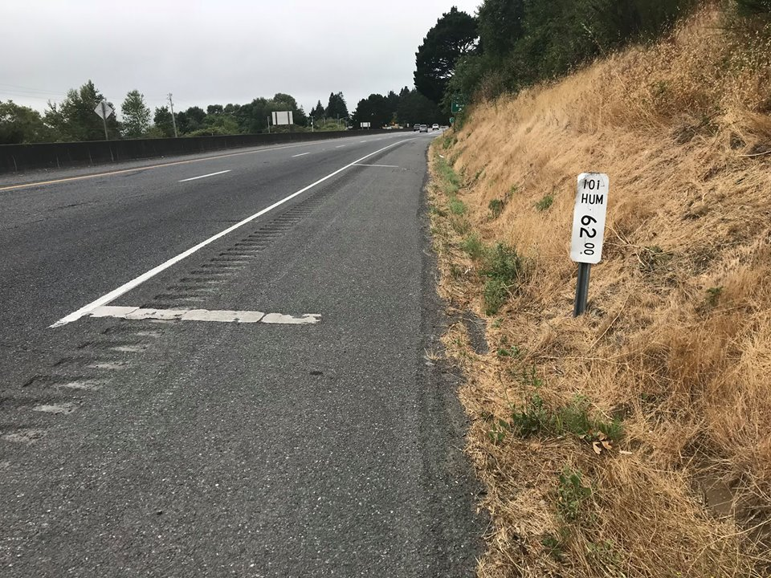
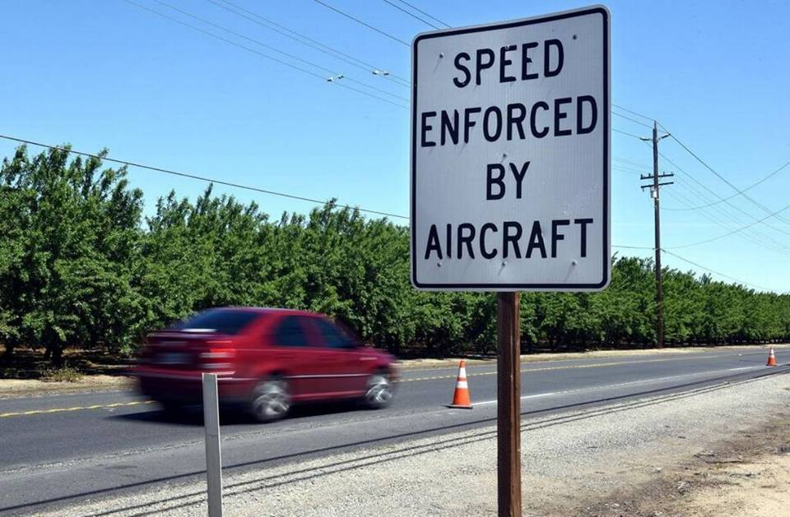
#26 Highway Mile Markers
Every mile on a freeway has a perpendicular marker painted on the road in addition to the mile marker signs. One of the uses of these marks is by the CHP to calculate your speed from the air by timing you from one marker to the next.

Slide 32
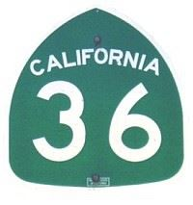
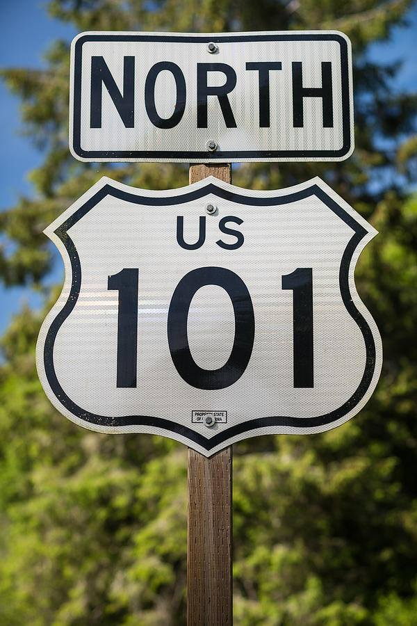
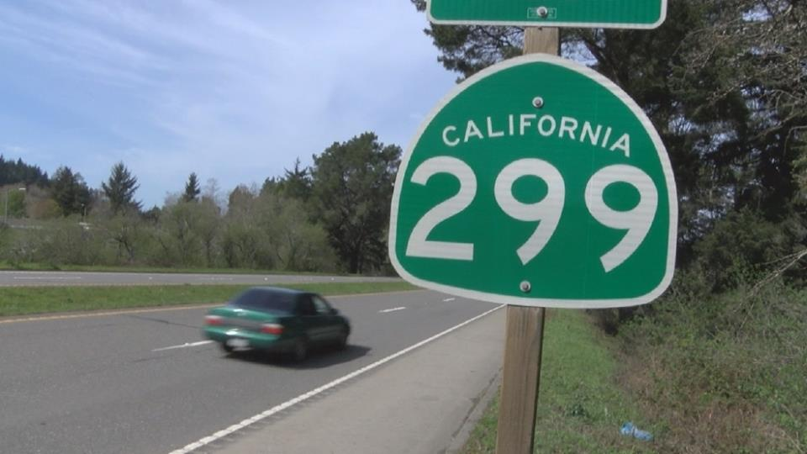
#27 Highway Numbers
Road are classified by their direction and connections.
North and south roadways are numbered with odd numbers.
East and West routes are even.
Interstate routes that branch off major roadways are designated with 3 digit numbers, like 299.
The last two digits of the number tell which highway is their origin. Highway 299 is a branch off highway 99.

Slide 33
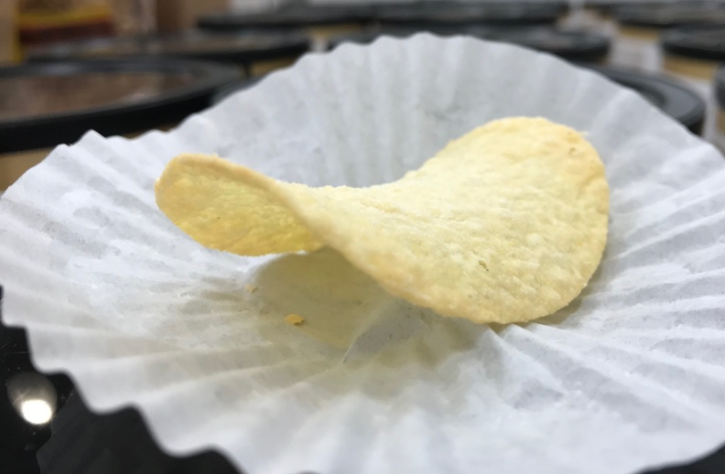
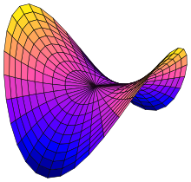
No 28 Pringle hyperbolic paraboloid
Pringles are a hyperbolic paraboloid.
Illustration by By Nicoguaro - Own work, CC BY 4.0, https://commons.wikimedia.org/w/index.php?curid=46973068

Slide 34
Why are manhole covers round?

Slide 35
A: Why Are Manholes Round?
Manhole cover releasing gases but staying in place

Slide 36
Manhole covers

Slide 37
No. 29 Road Percentage Gradient
The percentage describes the change in altitude over a 100 foot stretch. i.e. a 10% grade drops, on average, 10 feet for every 100 feet traveled or traveled horizontally (the calculations are virtually the same)
Hwy 36
Illustrations source:
Wikipedia
Angles in percentage, degrees and ratio

Slide 38
#30 Three Sphere Pawn Shop Signs
Three hanging spheres at a pawn shop. This symbol dates back to when most European were unable to read or write. At that time it represented banking or money lending.

Slide 39
34 Cord of Wood
A cord is 128 cubic feet of tightly packed wood measuring 4 feet high by 4 feet wide by 8 foot long. According to the Online Etymology Dictionary etymonline.com, the term was first recorded in the 1610's, so called because it was measured with a cord of wood. Other sources say it originates from bundles of wood being tied with a cord.

Slide 40
31. Home Plate
The pentagon with a squared back and pointed front became official shape for home plate in 1900-01 season. Prior to this "modern" adoption, home went through different shapes, including a circle. During that time, a large dinner plate was know to be used for the base. This may be the origin of "home plate". If you want to read more, there is good article from Major League Baseball site. https://www.mlb.com/…/why-is-home-plate-shaped-…/c-177695752 Another interesting aspect of the game is that the bases are run counter clockwise. I suspect to the advantage of right handed hitters.
Diagram source: www.quora.com

Slide 41
32 Reflection
My very least favorite sign in Fortuna, CA. It glaringly greets you as the first impression coming off the freeway from the north, but it does show reflection. From mathbitsnotebook.com: "A reflection is a kind of transformation. It is basically a 'flip' of a shape over the line of reflection. Very often reflections are performed using coordinate notation as they all are on this page. The coordinates allow us to easily describe the image and its preimage." Image also from mathbitsnotebook.com

Slide 42
33 Fresnel Lens
The challenge of lighthouse lens makers was being able to make a very large lens that would send a beam for miles. It needed to be very large, but couldn't weigh very much, and it needed to withstand the heat from a large lamp on one side and the cool air on the other without cracking. Fresnel (the "s" is not pronounced) knew that light refracts only at the surface where light goes from one medium to another. Taking this knowledge and amazing skill, he came up with giant lens design without all the internal glass.
This light is from the Table Bluff Lighthouse. It is currently in the Humboldt Maritime Museum in Samoa

Slide 43
Fire Hydrant Colors No. 35
 | The top and caps of fire hydrants are color coded to indicate the flow from the hydrant in gallons per minute (GPM) Thanks to members of the Eureka Fire Department their help
Source: http://www.firehydrant.org/info/hycolor.html
BLUE | 1500 GPM or more | Very good flows
GREEN | 1000-1499 GPM | Good for residential areas
ORANGE | 500-999 GPM | Marginally adequate
RED | Below 500 GPM | Inadequate

Slide 44
37 Egg Sizes
By USDA standards eggs are classified by grade and weight.
Size | Weight/ dozen | Approx wt/egg
Small | 18 ounces | 1.75 ounces
Medium | 21 ounces | 1.5 ounces
Large | 24 ounces | 2 ounces
Extra Large | 27 ounces | 2.25 ounces
Jumbo | 30 ounces | 2.5 ounces

Slide 45
38 Entasis
Entasis is the slight convex curving of a column to correct the visual illusion of concavity produced by a straight shaft (Wikipedia). You will also notice the top of columns are often much thinner at the top.
15.6 inches diameter
16.4 inches
17.5 inches
18.1 inches
18.3 inches
18.1 inches
There are amazing columns
In the Carson Building made from turned redwood logs
Morris Graves Museum at 636 F St.

Slide 46
39. Fire Hydrant Color Codes
The top and caps of fire hydrants are color coded to indicate the flow from the hydrant in gallons per minute (GPM)
Blue 1500 GPM or more Green 1000-1499 GPM Orange 500-999 GPM Red - below 500 GPM

Slide 47
40. Pierson’s Big Hammer
The Pierson's hammer is an exact replica of a Vaughan DO20 Claw Hammer. The original hammer is 14 inches long. The sign stands 26 feet tall. The head measures 10 feet 3 inches in length

Slide 48
41. McKinley Statue Arcata
William McKinley Statue on the Arcata Plaza. Politics aside, the statue is 8 feet 6 inches tall. McKinley was 5 feet 7 inches tall.
This makes the McKinley to statue height ratio 1:1.5

Slide 49
42. Wes Green Flag Hwy 101
Wes Green Flagpole beside Hwy 101 near McKinleyville. The 100 foot tall flag pole was installed in 1990 or 1991. During fair weather a 30 x 50 foot flag is flown - said to be the biggest flag in California. During the storm and winter weather months a 20 x 30 foot flag flies. 1:1.5 and 1:1.6 ratio respectively.

Slide 50
43. Native Basket Designs
Humboldt and the surrounding areas are the home of some of the finest basket makers in North America. The Clark Museum in Old Town Eureka has an extraordinary collection. The basket feature an array of geometric designs that are also seen in hats and applications.
Theknittree.com

Slide 51
44. Candy Geometry

Slide 52
Water Towers and water pressure
Use the formula Pressure (P) = 0.433 × height of water in feet (h) to calculate the psi for elevated water storage tanks.

Slide 53
Plimsoll lines on ships
Source: flowersforsocrates.com

Slide 54
Around your school #1
Definition
A parabola is a curve where any point is at an equal distance from:
a fixed point (the focus ), and
a fixed straight line (the directrix )
Parabolas

Slide 55
Around your school #2

Slide 56
Around your school #3

Slide 57
Around your school #4

Slide 58
Hubcap Symmetry

Slide 59
Other areas to explore and other cool stuff!

Slide 60
Q: What ball cover is a tessellation?
Source: istockphoto.com

Slide 61
A: What ball’s covering is a tessellation?
Source: mathworld.wolfram.com

Slide 62
How teeth are mapped

Slide 63
The Mason’s Symbols
Image source: israelect.com

Slide 64
Gears and gear ratios

Slide 65
Grate and vent designs

Slide 66
Spirals

Slide 67
Tessellations and Patterns

